Slide 1

Severity of Car Accidents
Abdulla Eid

Slide 2
Background
Car accidents cost millions of lives loss and billions of money loss every year.
The severity of a car accident is the most important factor in categorizing car accidents
Determining the severity of a car accident will include the location of the accident, weather conditions, car speeding, road conditions, number of people and vehicles involved in the accident

Slide 3
Data Set
The data for this project has been provided by the Seattle Police Department and recorded by Traffic Records which has been shared to us via link by Coursera
A detailed data base of car accidents that happened in Seattle from 2004 till now can be found here.
There are 194673 observations in the file with a target attribute is the severity of the accident which is categorial variable with only two values, 1 for moderate and 2 for severe

Slide 4
Feature Selection
Feature | Meaning
SEVERITYCODE | The severity of the accident
X | The x coordinate of the accident
Y | The y coordinate of the accident
ROADCOND | The condition of the road
WEATHER | The weather condition
JUNCTIONTYPE | The type of the junction where the accident took place
PERSONCOUNT | No of people involved
VEHCOUNT
INCDATE | Date of the accident
ADDTYPE | The Type of the address (Alley, Block, Intersection)
COLLISIONTYPE | Collision Type
Target variable is SEVERITYCODE

Slide 5
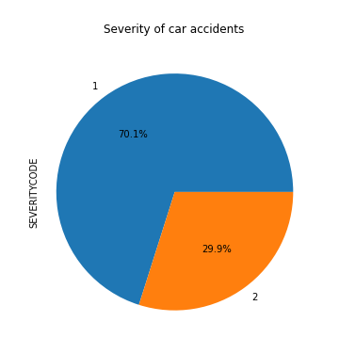
The target variable

Slide 6
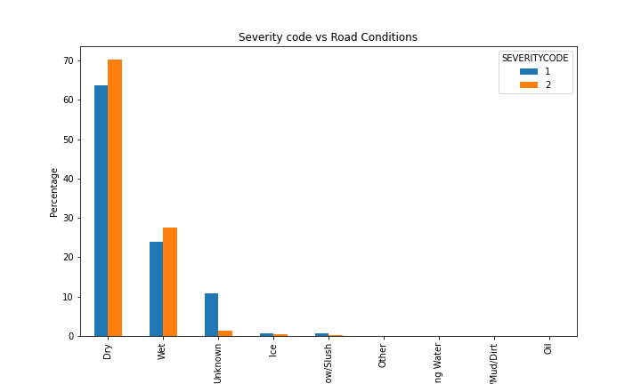
Relationship between Severity and Road Conditions
As in Figure below we notice that the most two road conditions with incidents are Wet(30%) and Dry(70%). To some extend, we would expect more sever injuries associated with the wet road conditions.

Slide 7
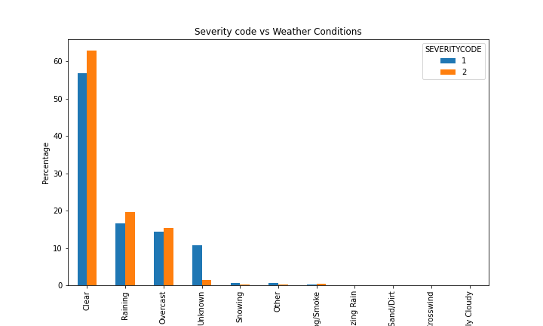
Relationship between Severity and Weather Conditions
The sever injuries happen in the clear weather (60%) while that in the raining or overcast is only accountable for 40%.

Slide 8
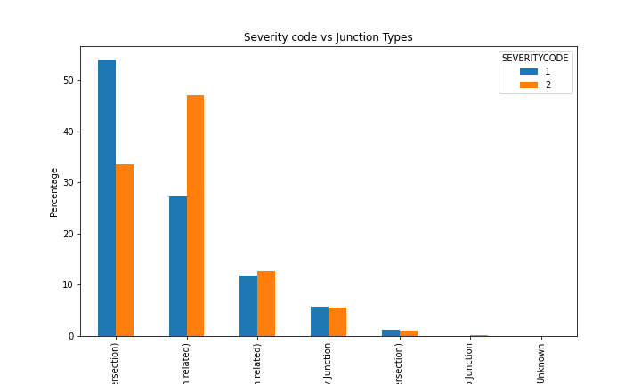
Relationship between Severity and Junction Types
The severe injuries occur in intersection and intersection related junction or in the driveway

Slide 9
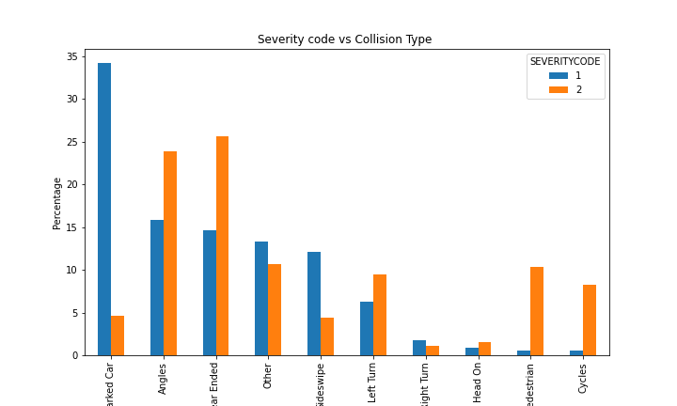
Relationship between Severity and Collision Type
Accidents involve pedestrians and bicyclists result in severe injuries. In addition, rear-end and angles accidents are also sever accidents.

Slide 10
Predicated Models
Data were split into 80% training dataset and 20% testing dataset
3 main models were built and trained using the data set with the attribute mentioned the previous slides, namely K-nearest neighbor, decision tree, and logistic regression.
3 metrics were calculated for each model (F1-score, Jaccord, and LogLoss)

Slide 11
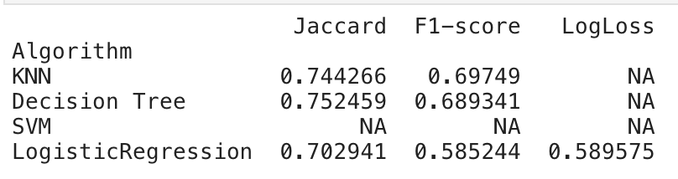
Accuracy of the ML models

Slide 12
Results
Severity of an accident depends mainly on wet road conditions.
Severity of an accident depends on rainy and overcast weather condition the most and happens in the intersections related road.
If an accident happened in the rear part of the car, the severity of the injury is most likely to happen
The built model can predict the severity of an accident given the factors of the road condition, weather condition, junction type, collision type

